Slide 1
Bike Rack
Mass Production Report - A7
Carly Buchanan, Cooper Pursley, Emerson Daigle, Luca Tramontozzi

Slide 2
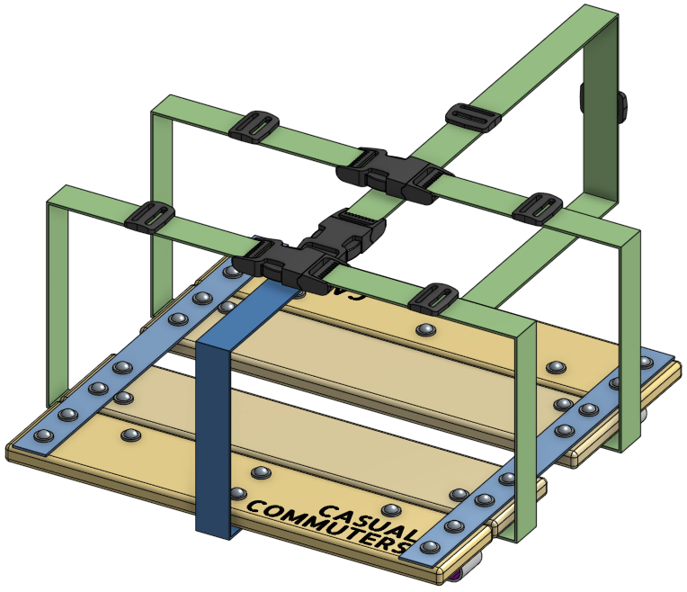
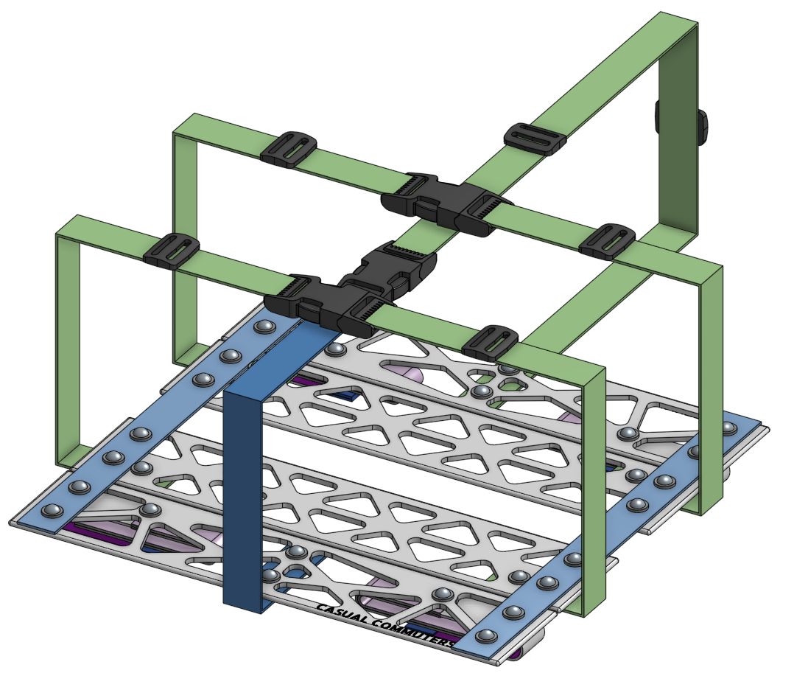
Design Changes for Mass Manufacturing
PVT
Mass Manufacture
Form slats from 6061 Aluminum for increased stiffness & durability.
Aluminum slats can be thinner than wood slats, making the platform thinner when folded and easier to stow.
Eliminate need to seal slats with lengthy dry times between coats.
Bead blast finish to eliminate burrs & provide some texture to the aluminum surface.
Screen print logo application.

Slide 3
aPriori: Manufacturing Insights
Inputs:
Inner & Outer Slat Manufacturing
  Turret Press
  Bead Blasting
  Screen Print (outer only)
  Mexico Region
  Volume: 5,500 over 5 years
Assembly
  Riveting operation (28 rivets)
  Sewing, strap assembly, assembly jig population estimated at 0.5hr labor at $2.43/hr rate
  Does not take into account setup time, overhead, fixtures, jigs, etc. due to estimation solely off labor rate
  Labor rate from aPriori Mexico Region
Outputs:
Fully burdened cost per piece
  Outer slat: $1.91
  Inner slat: $1.94
Riveting process fully burdened cost
  $0.24
Other Assembly costs
  $1.22

Slide 4
Bulk Purchasing
For our many purchased parts we couldn’t easily include in aPriori, we externally researched how the price would change with bulk orders for mass manufacturing (MM)
 | Purchasing |  |  | Comparison
Item | Purchase Dimensions /Qty | Purchase Qty for Bulk Price | Extended Cost /Purchase | Our Cost /Platform | MM Cost /Platform | Savings /Platform
Webbing | 1" x 300' | 1 | $60.00 | 6.36 | 3.18 | 3.18
Rivet (3/16" x 3/4") | 3000 ct | 1 | $261.15 | 2.88 | 2.09 | 0.79
Washers (3/16") | 10000 ct | 1 | $399.95 | 2.4 | 1.92 | 0.48
Buckle | 1500 ct | 1 | $390.00 | 3.69 | 0.78 | 2.91
Slide | 9000 ct | 1 | $630.00 | 1.96 | 0.49 | 1.47
Hook and Loop (Hook) | 1" x 75' | 3 | $48.00 | 1.25 | 0.44 | 0.81
Hook and Loop (Loop) | 1" x 75' | 3 | $48.00 | 2.50 | 0.88 | 1.62
TOTAL |  |  |  | 21.04 | 9.29 | 11.26

Slide 5
Combined Costs
Final Results: a ~75% cost reduction
Used aPriori’s default volume & batch size
Likely undercounting the cost of final MM assembly due to lack of assembly setup & overhead costs, amortized costs of assembly fixtures, jigs, etc. as aPriori could not produce estimates for these
Does not include costs of shipping products in from Mexico region
Packaging is a target cost, not actually spent or simulated
PVT COSTS |  |  | MASS MANUFACTURING
Purchased Parts | $21.04 |  | Bulk Purchased Parts | $9.29
Slats | $28.46 |  | Slats | $7.70
Assembly | $23.33 |  | Assembly | $1.46
Packaging | $1.80 |  | Packaging | $1.80
Total COGS | $72.83 |  | Total COGS | $18.45

